Slide 1





TEAM DETAILS
Team Name: THE DECIDERS
Team ID:
Department name & Year: EEE College Name: PANIMALAR ENGINEERING COLLEGE

Slide 2
TEAM MEMBERS DETAILS
TEAM MEMBERS | DEPARTMENT | YEAR | ROLE
SIVARAM | EEE | III YEAR | Team Leader
JASHVEEN RAJ | EEE | II YEAR | Backend Programmer
PRADARSH | EEE | II YEAR | Website Designer
DEEPAK | EEE | II YEAR | App Developer
SUSHMITHA | EEE | III YEAR | Frontend Developer

Slide 3
Unethical Use of Dark Patterns in E-commerce
Dark patterns, which are deceptive design strategies used by e-commerce platforms to influence user behaviour, present significant obstacles to maintaining trust and transparency in online transactions.
EXISTING DARK PATTERN RECOGNITION TECHNOLOGY:
Traditionally, manual inspections and heuristic assessments have been the main techniques for spotting dark patterns. However, these methods are laborious, demanding in terms of resources, and subject to individual interpretation.
Existing Machine learning (ML) techniques have shown promise in identifying dark patterns by analyzing user interactions and interface components. However, these models typically rely on large amounts of labeled data and may struggle to generalize to new or unseen patterns.
OVERCOMING INEFFECTIVENESS WITH ML MODELS:
Our solution harnesses cutting-edge ML technology, particularly the Language Model (LLM) BERT, which has been fine-tuned with a customized dataset specifically tailored for detecting dark patterns.
Our ML model dynamically learns and adjusts to evolving dark pattern strategies, providing greater flexibility and scalability. By training on a diverse array of real-world dark patterns.

Slide 4
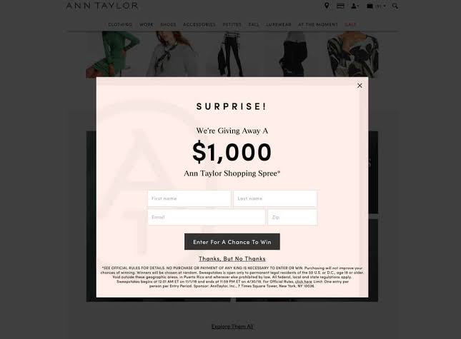

Understanding Dark Patterns in E-commerce
Dark patterns are deceptive design techniques employed by e-commerce platforms to influence user behavior in ways that may not align with the user's intentions or interests. These manipulative tactics can take various forms, such as misleading prompts, hidden costs, forced subscriptions, or fake urgency tactics. By exploiting psychological biases and user expectations, dark patterns create a frictionless path towards actions that benefit the platform at the expense of the user's autonomy and trust. Understanding these manipulative strategies is crucial for identifying and mitigating their impact on online consumers.
Fig: FORCED ACCOUNT CREATION
Fig: Ad DISPLAYING SOCIAL PROOF

Slide 5








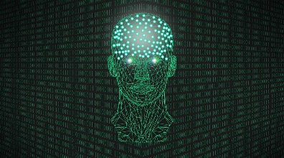
ARCHITECTURE DIAGRAM
User
Calls for backend
E-COMMERCE WEBSITE
WEB SCRAPING
‘Puppeteer’ and ‘beautifulsoup’
FLUTTER APP
cross browser compatibility.
Sends prediction Signal
Alert and highlights are given
Phi-2 model Constantly updating the dataset
Dark pattern
detected !
Scrapped text analysis – BERT model

Slide 6






APPROACH TO PROBLEM STATEMENT
SOLUTION OVERVIEW :
Our solution comprises a BERT model trained on a custom dataset of 2000 Dark pattern data extracted from a pool of e-commerce websites through web scraping. Leveraging the Hugging Face Transformers library, our model is fine-tuned using auto-tokenizers tailored for BERT-base-cased models, facilitating efficient text processing for dark pattern detection.
Data preprocessing and manipulation are handled using Pandas and NumPy libraries, ensuring streamlined organization and numerical computations essential for model training.
we're developing a user-friendly application using Flutter, a cross-platform framework known for its flexibility and efficiency. Flutter enables us to create visually appealing and responsive mobile interfaces, ensuring seamless access to our dark pattern detection capabilities across various devices and operating systems.
By integrating our BERT model into this application, we aim to provide consumers with intuitive tools to navigate e-commerce platforms transparently and confident.
TECH STACK USED

Slide 7
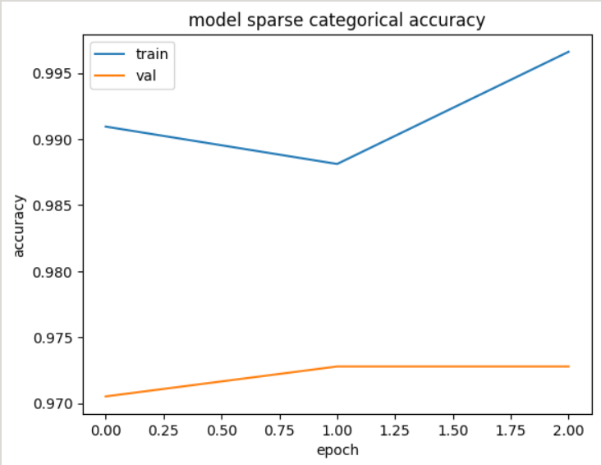
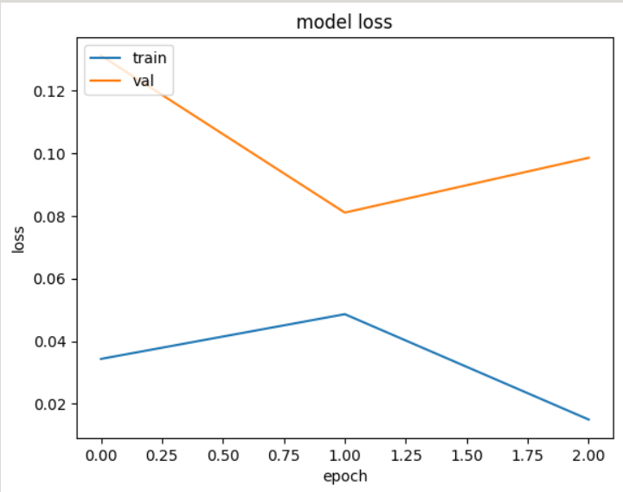
TRAINING AND TESTING OF OUR MODEL
Our dark pattern detection algorithm relies on the state-of-the-art BERT (Bidirectional Encoder Representations from Transformers) model. BERT, a revolutionary advancement in natural language processing (NLP), excels in understanding contextual information within text data.
For training, we utilized a Custom dataset sourced from an open-source platform, comprising approximately 2000 instances of dark pattern data extracted from over 11,000 e-commerce websites across the web.
In the implementation of our BERT model, we leveraged a stack of essential libraries including TensorFlow for efficient neural network computation, Hugging Face for accessing pre-trained BERT models and fine-tuning them with our dataset, NumPy and Pandas for data manipulation and preprocessing, Matplotlib for visualizations, and the 'bert-base-cased' tokenizer for encoding textual input into suitable representations for BERT.
During training, our model achieved impressive performance metrics, with a Test accuracy of 0.9662 and a Loss of 0.1296.The high accuracy and low loss values demonstrate the effectiveness of our approach in training a robust dark pattern detection system.
Overall, our implementation of the BERT model combined with a carefully curated dataset and advanced technical specifications has enabled us to develop a powerful algorithm for detecting dark patterns in e-commerce.
BERT MODEL EFFICIENCY
1.Test Accuracy:
0.9662 ~ 96%
2.Eval-Loss:
0.1296

Slide 8
EFFICIENCY OF OUR SOLUTION AND OUR FUTURE IMPROVEMENTS
Our current trained BERT model demonstrates proficiency in detecting several types of dark patterns prevalent in e-commerce platforms. Websites employ fake timers or stock level indicators to create a false sense of urgency and scarcity, compelling users to make hasty decisions.
Additionally, the model effectively recognizes deceptive user interfaces, forced actions, and instances of misdirection, where crucial information is omitted or obscured to manipulate user behavior. Moreover, it can detect sneaky tactics such as hidden costs in the checkout process
While our current model addresses these dark pattern parameters with high accuracy, we acknowledge that there are additional aspects of dark patterns that require further refinement and development.
Our ongoing efforts are focused on enhancing the model's capabilities to detect dark patterns related to subscription manipulation, unnecessary account registrations, limited user options, and manipulated user-generated content such as fake reviews.
Through continued research and iterative model improvement, we aim to expand the scope of our dark pattern detection system to comprehensively address all aspects of deceptive design tactics employed by e-commerce platforms.
TEST ACCURACY OUTPUT

Slide 9
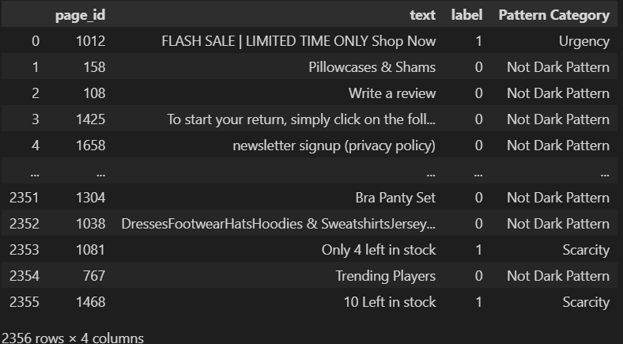
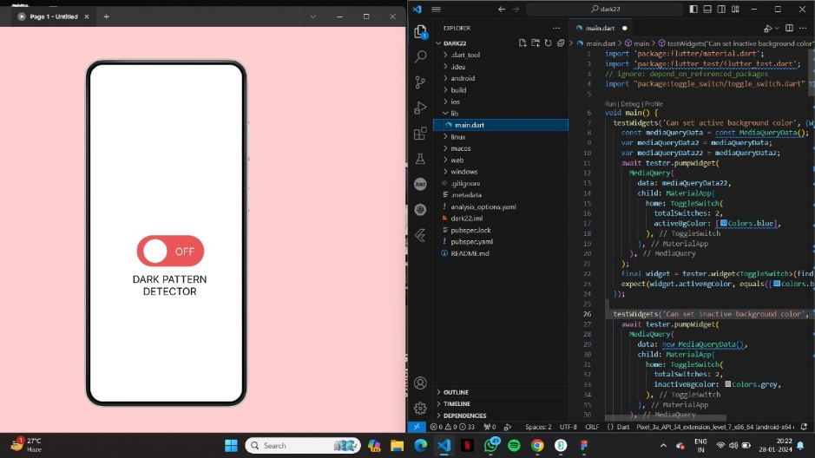
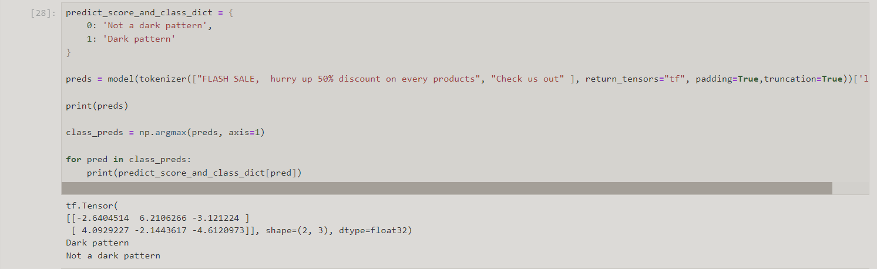
By leveraging advanced machine learning techniques and collaborating with domain experts, we are committed to developing a robust and versatile solution that empowers consumers with the knowledge and tools needed to navigate online shopping experiences with confidence and integrity. Our dedication to innovation and continuous improvement reflects our mission to combat deceptive practices and uphold the principles of transparency and fairness in e-commerce.
DATASET USED FOR TRAINING OUR MODEL
SAMPLE FINAL OUTPUT
OUTPUT FROM PROTOTYPE

Slide 10
WEB SCRAPPING TECHNIQUES USED
For our approach of detecting dark patterns through machine learning (ML) models, we utilize web scraping techniques to gather data from various e-commerce websites. This data serves as the foundation for training and testing our ML model, enabling it to identify and classify deceptive design practices effectively. To accomplish this, we employ standard web scraping code alongside a headless browser tool called Puppeteer.
Web scraping involves programmatically extracting information from websites, allowing us to collect valuable data relevant to our research objectives. By accessing the HTML structure of web pages, we can extract textual content, images, and other relevant information necessary for training our ML model. This process involves navigating through website pages, identifying target elements, and extracting relevant data in a structured format for further analysis.
Puppeteer, a headless browser tool developed by Google, plays a crucial role in our web scraping workflow. Unlike traditional browsers, Puppeteer operates without a graphical user interface, making it ideal for automated browsing tasks. By simulating user interactions, such as clicking buttons and filling out forms, Puppeteer enables us to navigate through websites and extract data programmatically. Its headless nature allows for efficient and seamless web scraping operations without the need for manual intervention.
By combining standard web scraping code with Puppeteer, we can efficiently gather data from e-commerce websites for training our ML model. This approach not only allows us to collect a diverse range of data relevant to dark patterns but also ensures the scalability and reliability of our data collection process. Ultimately, the data obtained through web scraping serves as the cornerstone of our ML-based approach to detecting and combating deceptive design practices in the online retail landscape.

Slide 11
FEATURES DETECTED BY OUR PROTOTYPE
1.Urgency:
- Identify aggressive language and countdown timers.
- Scrutinize contextual cues and linguistic patterns.
- Flag instances coercing users into hasty actions.
2.Scarcity:
- Analyze stock counters and time-limited offers.
- Assess progress bars and demand indicators.
- Detect attempts to induce impulsive behavior.
3.Misdirection:
- Examine deceptive design elements.
- Evaluate user intent alignment.
- Identify diversion tactics and unintended actions.
4.Social Proof:
- Analyze content authenticity and engagement.
- Detect fabricated testimonials and biased reviews.
- Expose attempts to boost credibility artificially.
5.Sneaking:
- Scrutinize consent mechanisms and privacy policies.
- Identify hidden clauses and surreptitious data collection.
- Expose attempts to manipulate user consent.
6.Forced Action:
- Analyze coercive language and aggressive design.
- Assess temporal factors and user engagement.
- Flag instances of user coercion.

Slide 12


FIG: SAMPLE SITE BEFORE DETECTION.
FIG: OUR TRAINED MODEL DETECTING DARK PATTERN IN OUR TEST SITE.

Slide 13
SOURCE CODE
GitHub Link: https://github.com/JashveenRaj/Dark-pattern-detecction.

